Slide 1
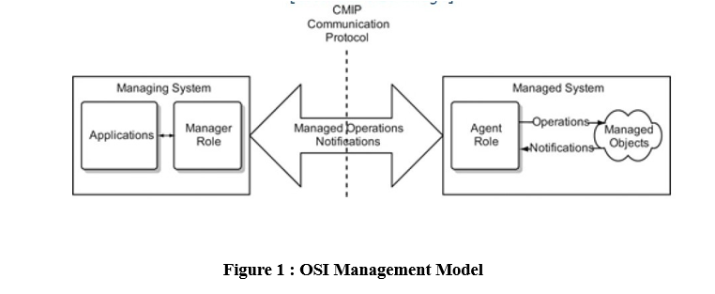

Slide 2
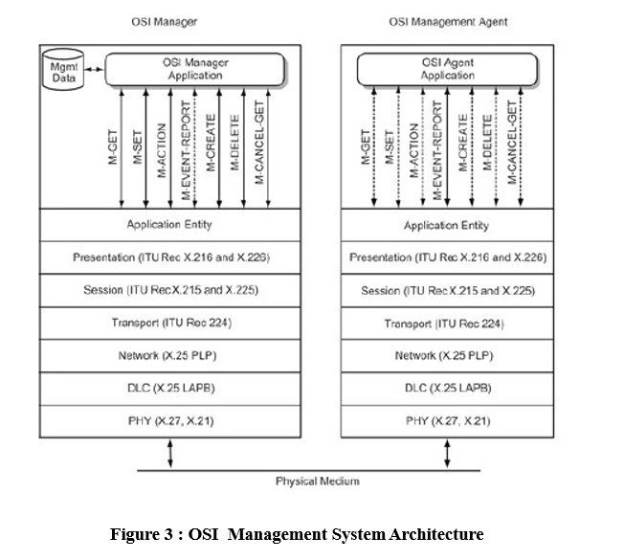

Slide 3
M-GET
This service comprises request and response messages. The M-GET requires confirmation from the agent.
M-SET
This service enables setting up attribute values in the managed object and may or may not require confirmation.
M-ACTION
This service is used to perform operations in the managed object, and confirmation is optional.
M-CREATE & M-DELETE
These services are used to create and delete object classes, for which there is no equivalent in SNMP. Both these OSI messages require confirmation from the agent.
M-CANCEL-GET
An M-GET request message may be canceled by using the M-CANCEL-GET message, which requires confirmation from the agent.
M-EVENT-REPORT
This service is akin to the trap message in SNMP, but it has a much broader effect than the few generic alarms in SNMP

Slide 4
Communication Model
The manager and agent application processes uses seven messages to communicate with each other. The application process interfaces with the application entity sublayer that is above the presentation layer. The communication protocol used for intersystem communication is the Common Management Information Protocol (CMIP). The communciation model deals with the application entity layer and the intersystem message protocol.

